Slide 1

Quick guide for Fortran: Intel Fortran compiler and Visual Studio
Hyoungseok Kang

Slide 2
Fortran?
FORmula TRANslation (made by IBM, 1954)
The first high-level programming language
Version update with backward compatibility (66→77→90→95→2003→2008)
Mathematics & Science libraries
Strong at High Performance Computation (HPC)
Broadly used in numerical analysis (e.g., Climate modeling, Rocket simulation)

Slide 3
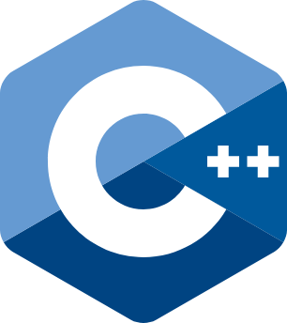
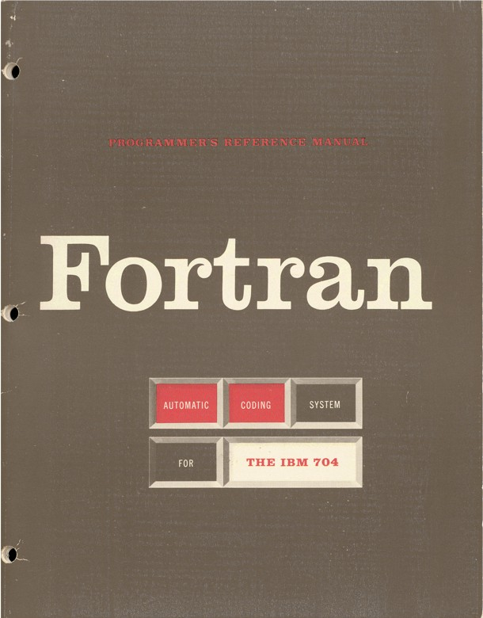
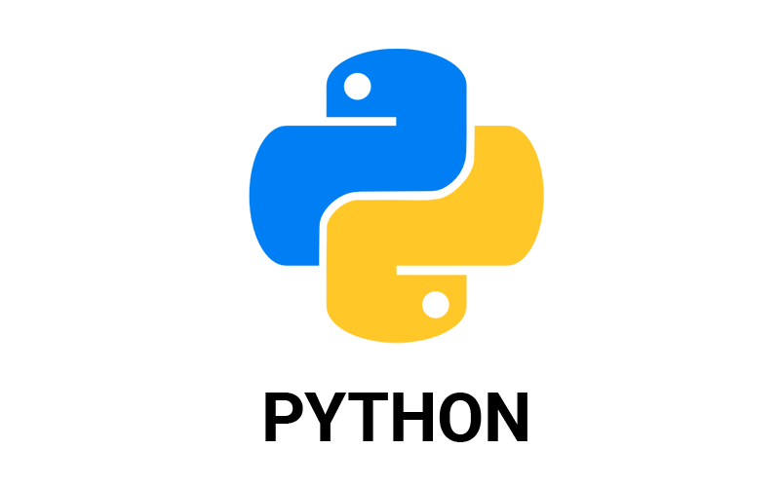

Fortran compiler
Open-source compilers
GNU Fortran Compiler (gfortran)
LLVM Flang
High-level language
(Human-readable)
languages
Commercial compilers
Intel oneAPI
Fortran Compiler Classic (ifort)
Fortran Compiler Beta (ifx)
NAG Fortran Compiler
NVIDIA, IBM, AMD, ARM, Oracle, Cray…
Compiler
(Translation)
Higher performance
& stability
architectures
Machine code
(CPU-readable)

Slide 4
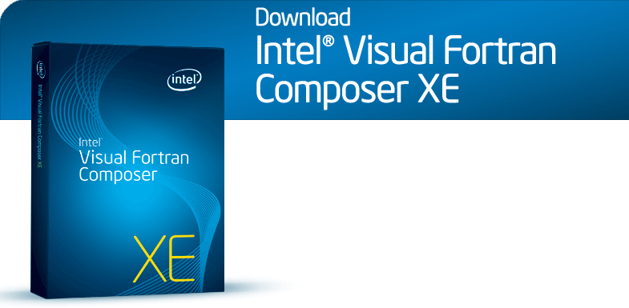
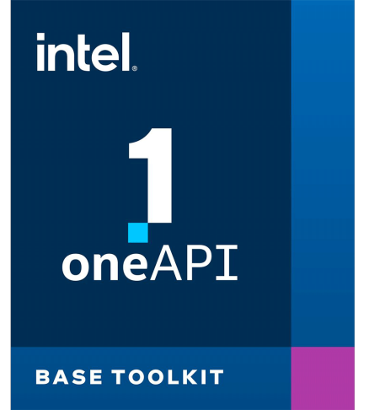
So… why are we here?
+ IDEs
Our lab has Intel Visual Fortran 2013 license.
Rebranded
Product update ended
in Dec. 2020

Slide 5
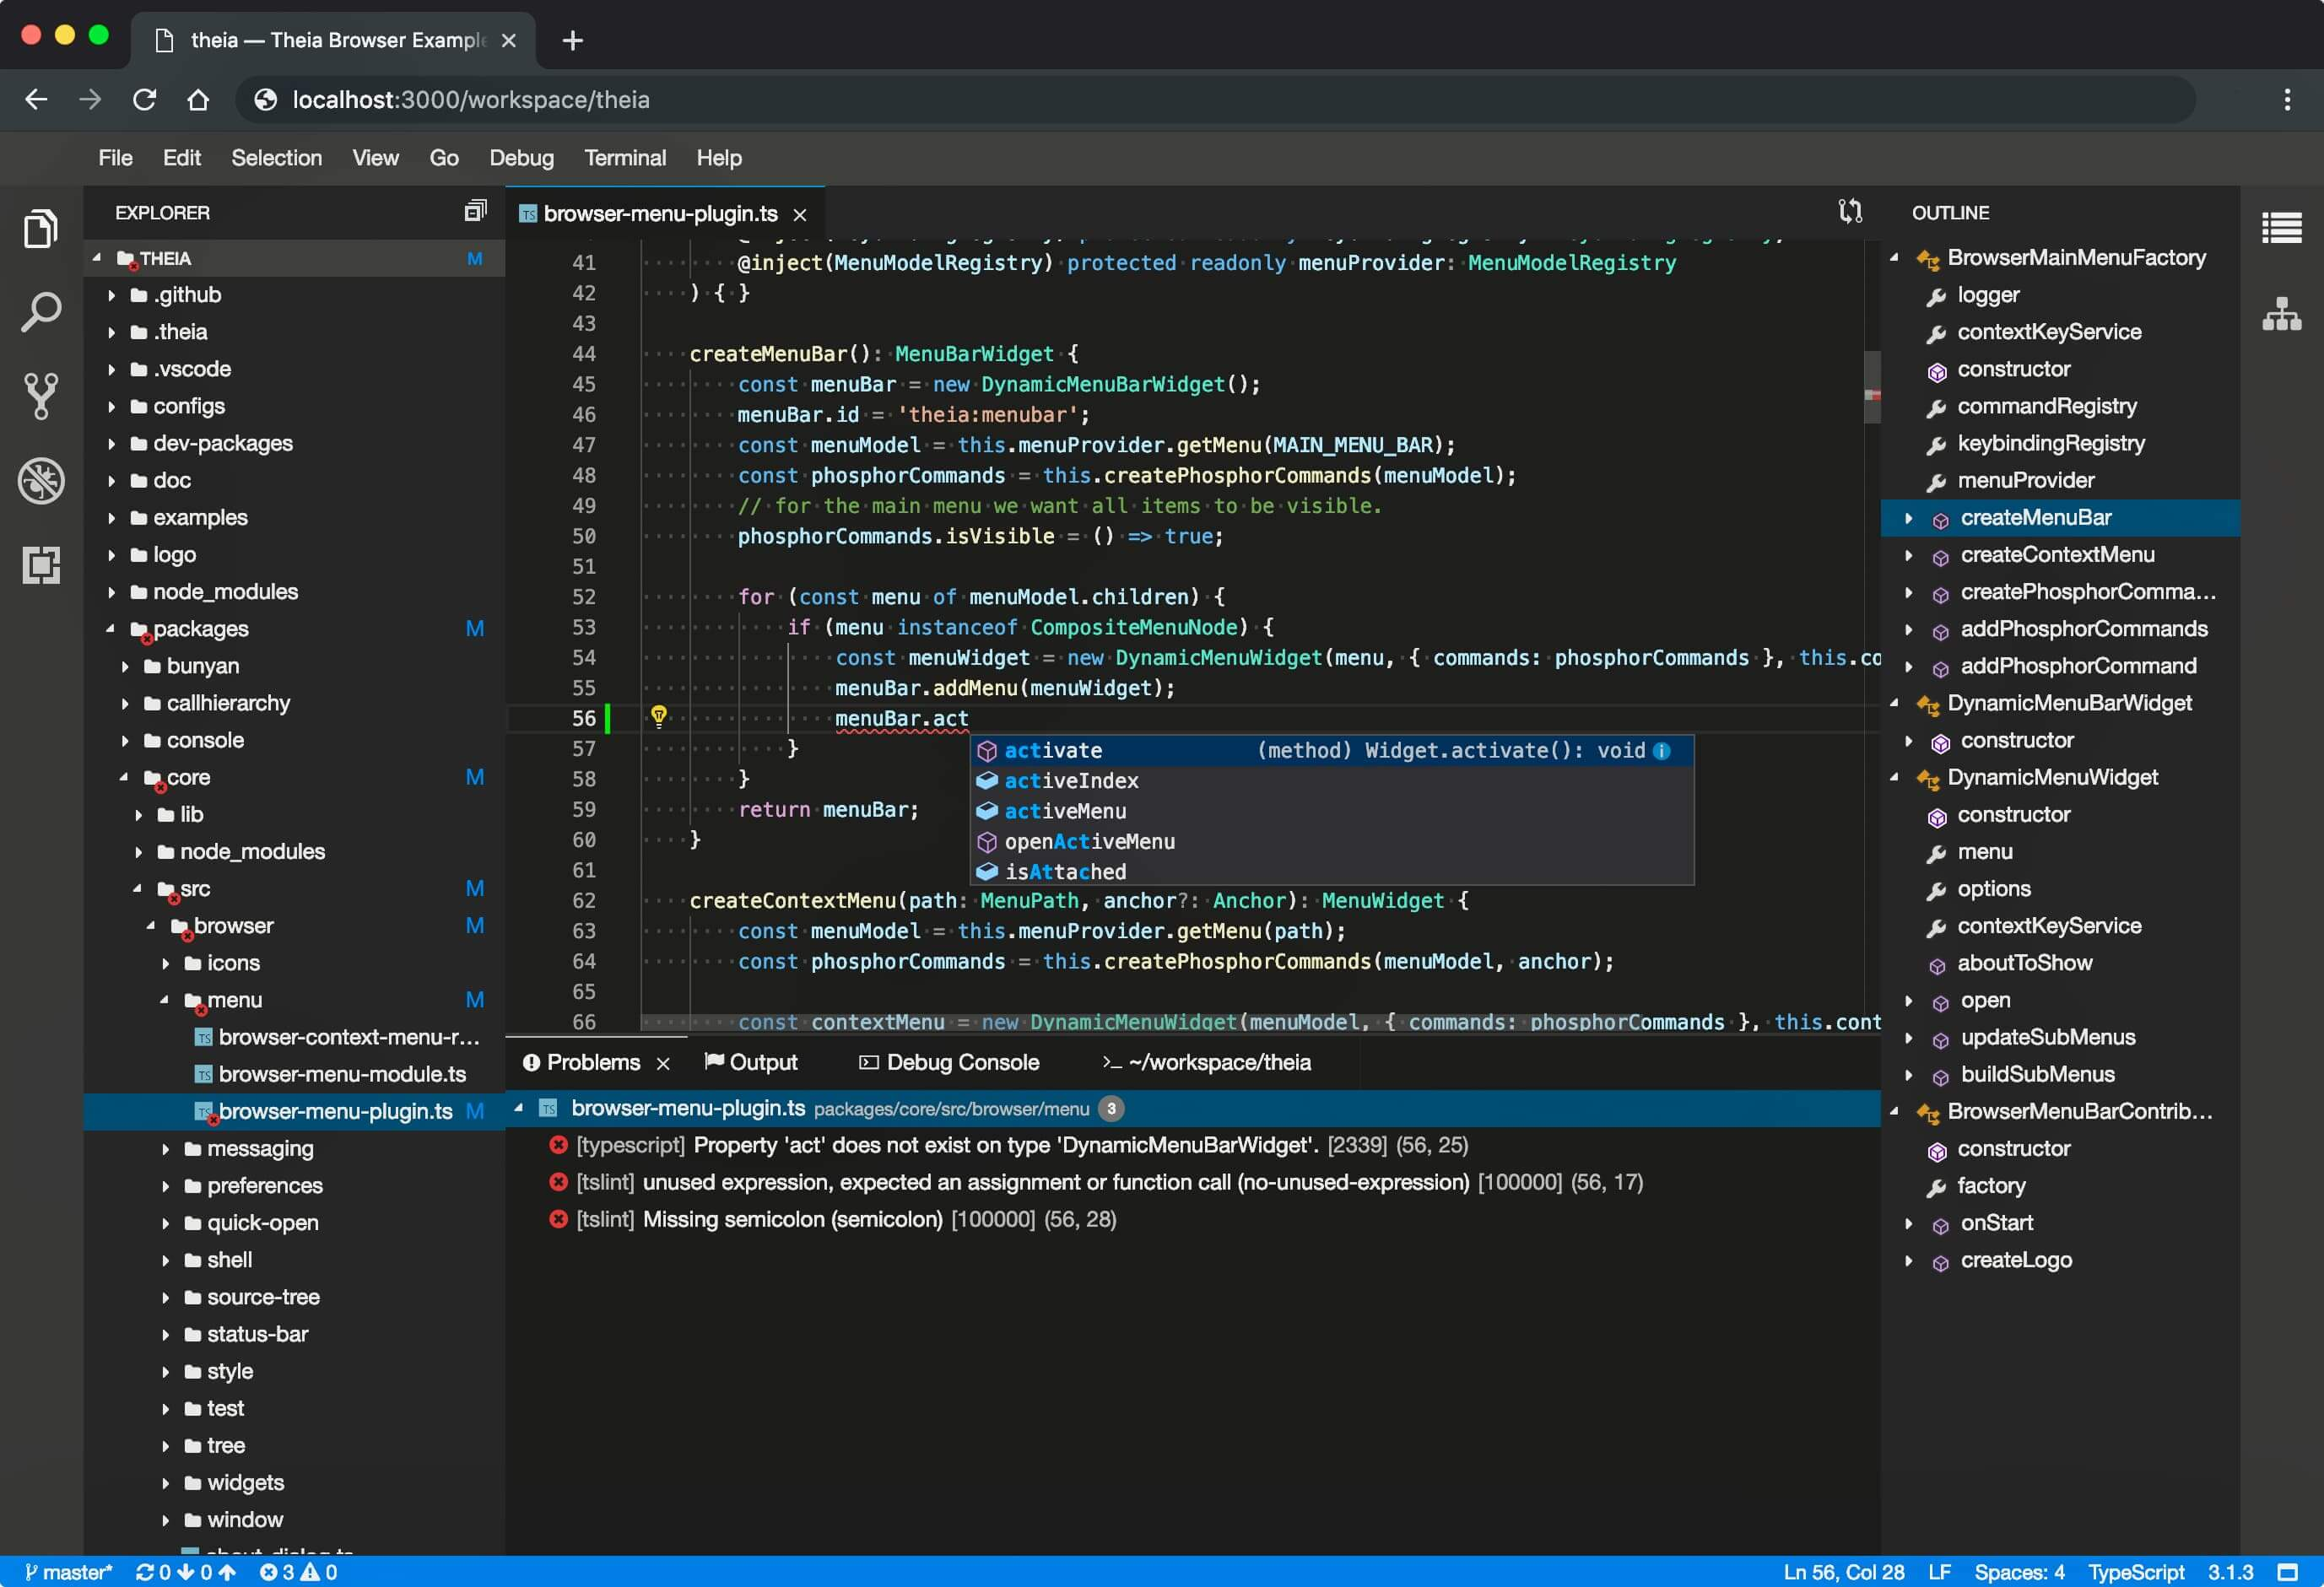
Integrated Development Environment (IDE)
Provide whole procedures in program development
Code editing (Auto-completion)
Debugging (Error-report)
Compiling
Distribution
Most Popular IDE
Visual Studio
Eclipse
Xcode
IntelliJ IDEA
Code Editor
Compiler
Debugger
Common appearance of IDE

Slide 6
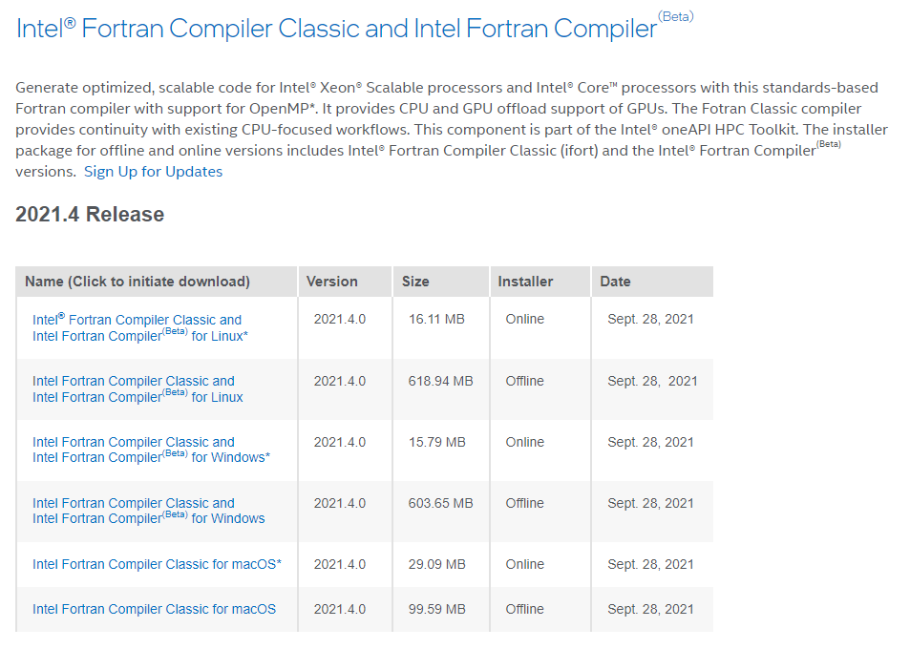
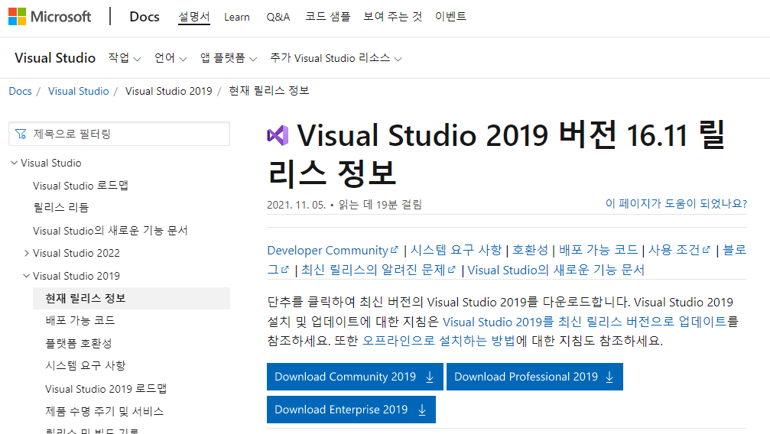
Shall we download and install them?
Intel Fortran complies with
Visual Studio 2019 (Windows) - community ver. is free for student
Xcode (Mac)
Eclipse (Linux)
2021. 3 Release works perfectly! (Do not install 2021.4)
3. Intel Fortran for Windows (Online)
Visual Studio 2019 Community
Install VS - Desktop Development with C++

Slide 7
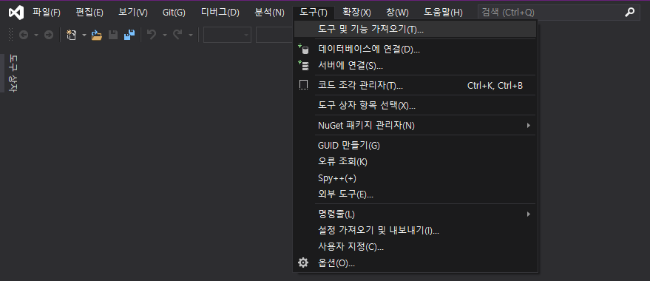
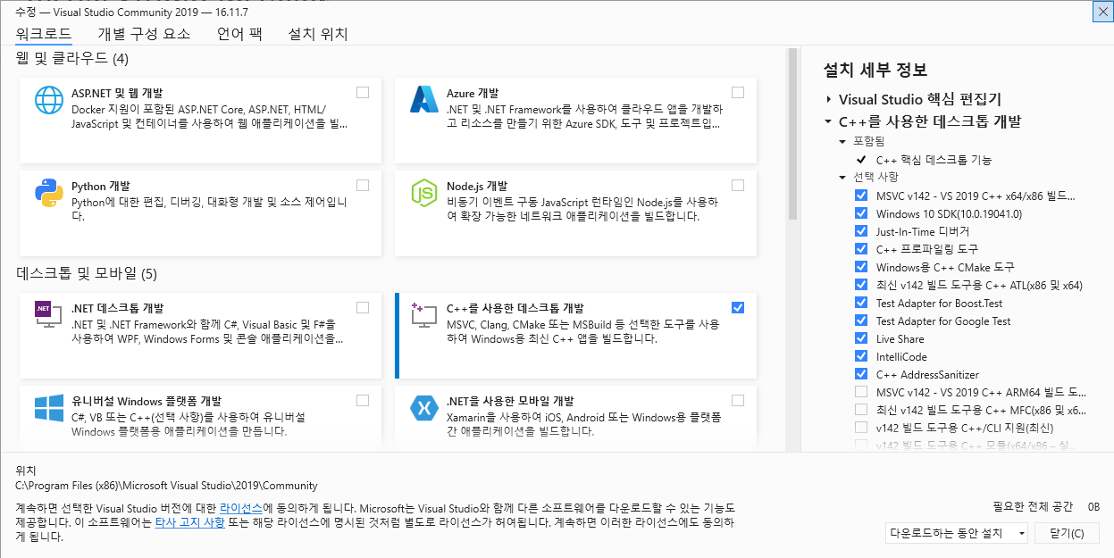
When VS was already installed without C++

Slide 8
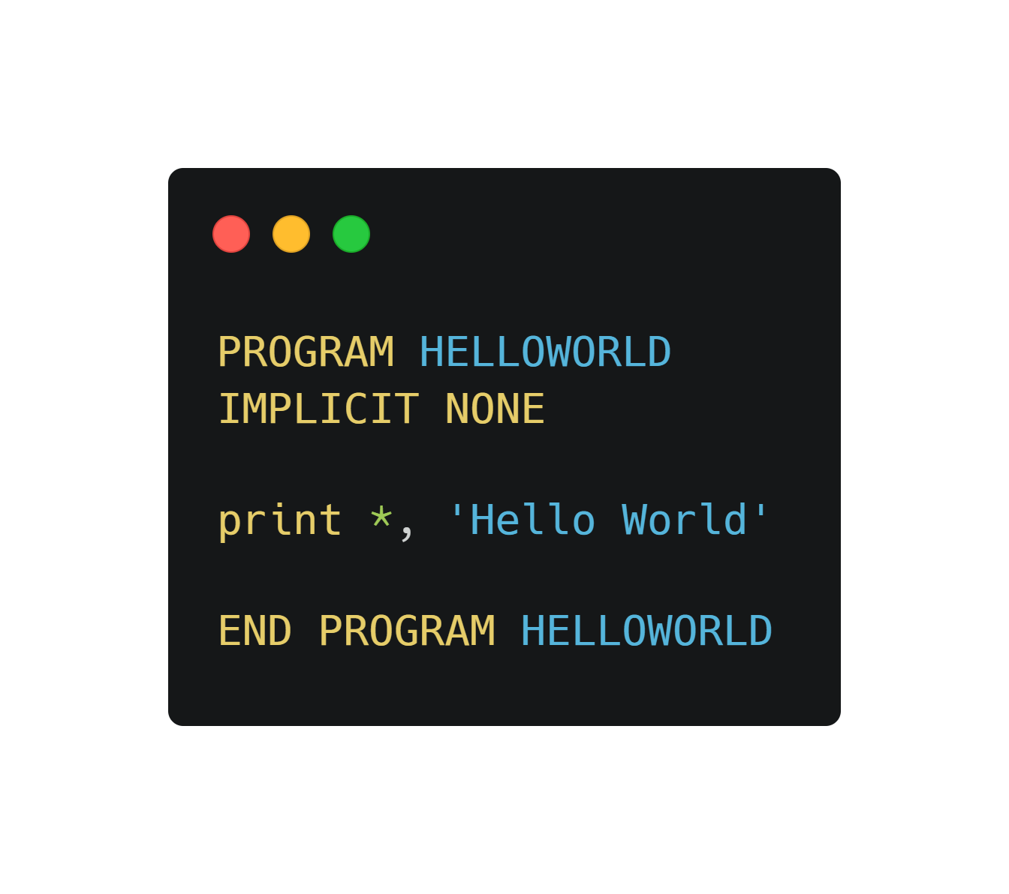
Hello World!
Every Fortran program starts with PROGRAM [code_name].
END PROGRAM [code_name] informs the end of code.
The meaning of “Implicit none”
Earlier ver. Fortran identifies variables implicitly when they begin with :
1. I, J, K, L, M, N : Integer
2. other alphabets : Real number
* Fortran is case insensitive

Slide 9
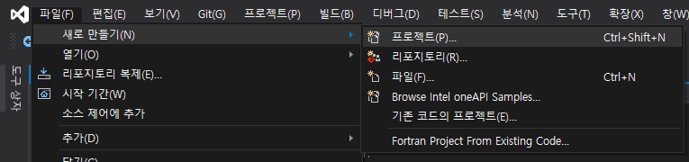
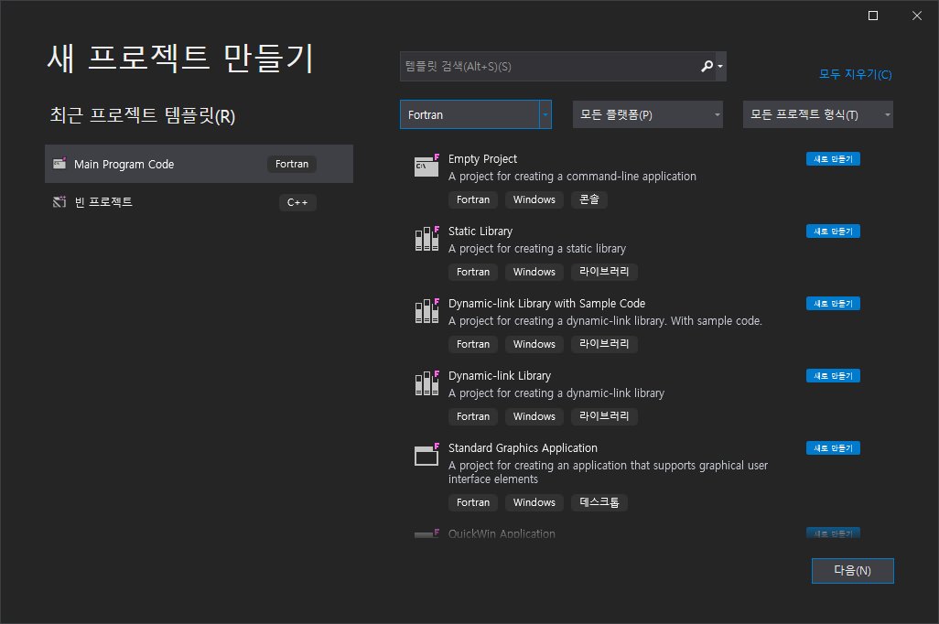
Build ‘Hello World!’
1. File – New - New Project (Ctrl+Shift+N)
2. Select “Empty Project” Fortran language
3. Write the code in the editor
4. Debug-Start without Debug (ctrl+F5)
Do you see a prompt window?

Slide 10
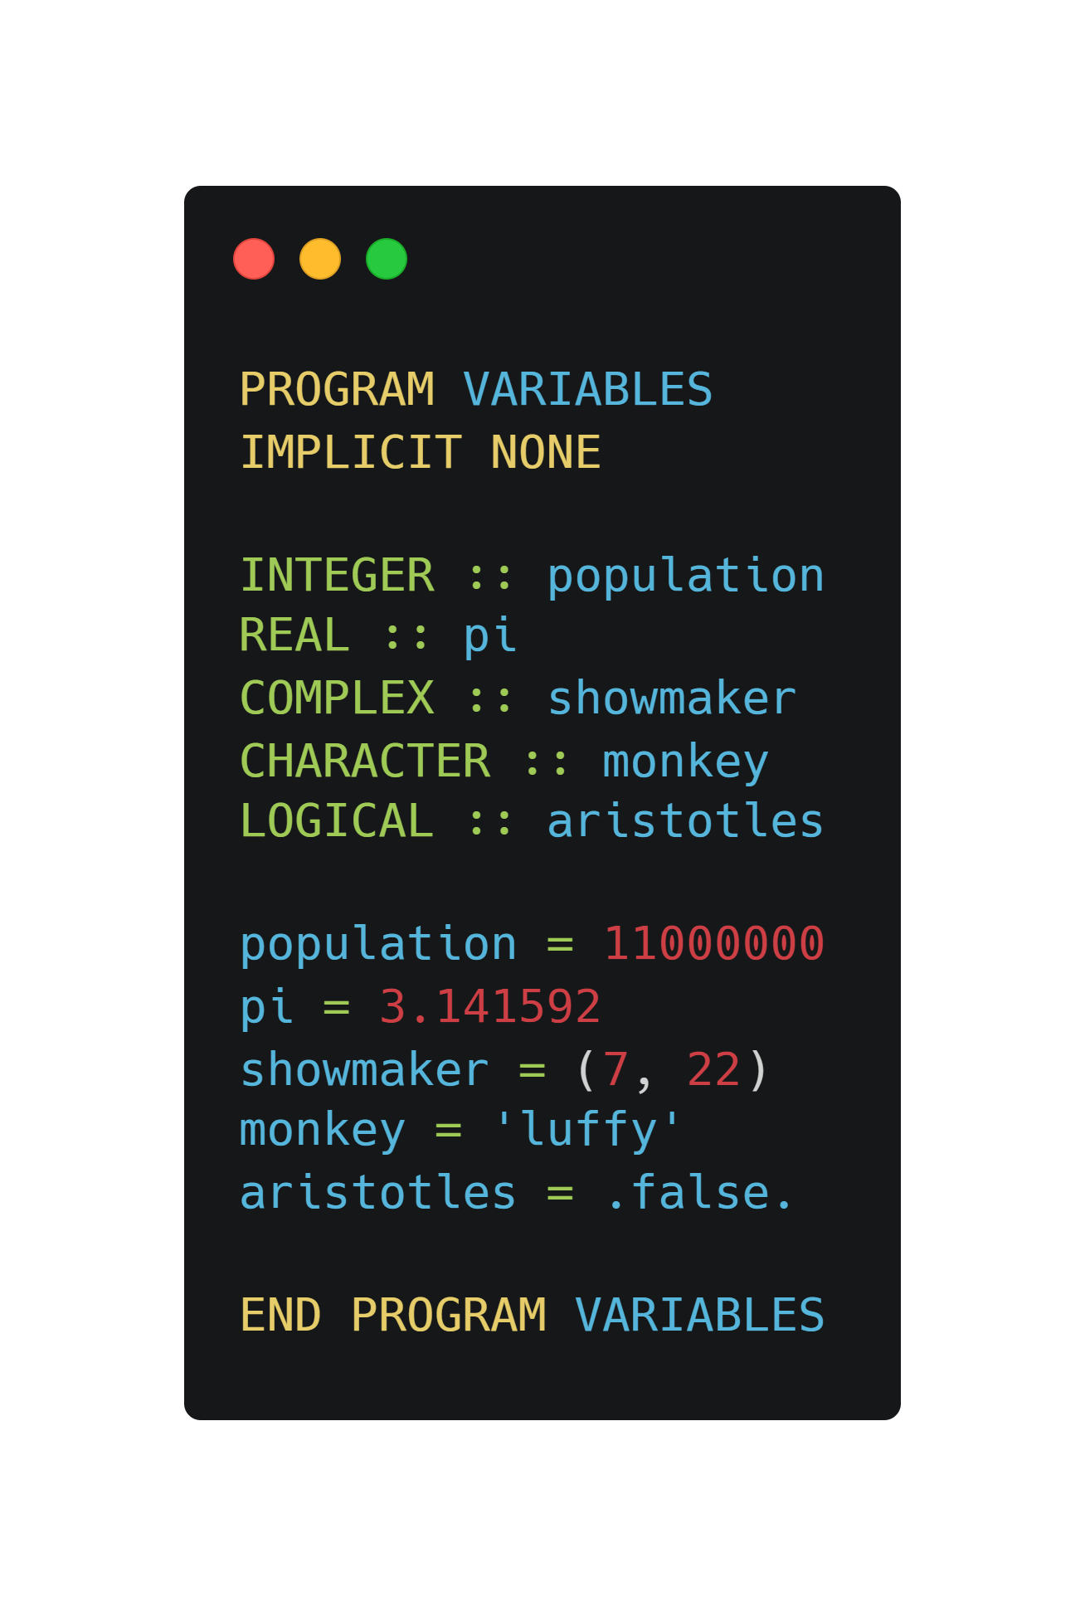
Variable declaration
There are 5 built-in variable types in Fortran:
Integer, Real, Complex, Character, Logical
Syntax:
<Variable_Type> :: <Variable_name1>
<Variable_Type> :: <Variable_name2>, <Variable_name3>
Complex number a+bi is denoted as (a, b)
String is embraced by single(‘ ’) or double quote(“ “)
Logical expression : .true. or .false.

Slide 11
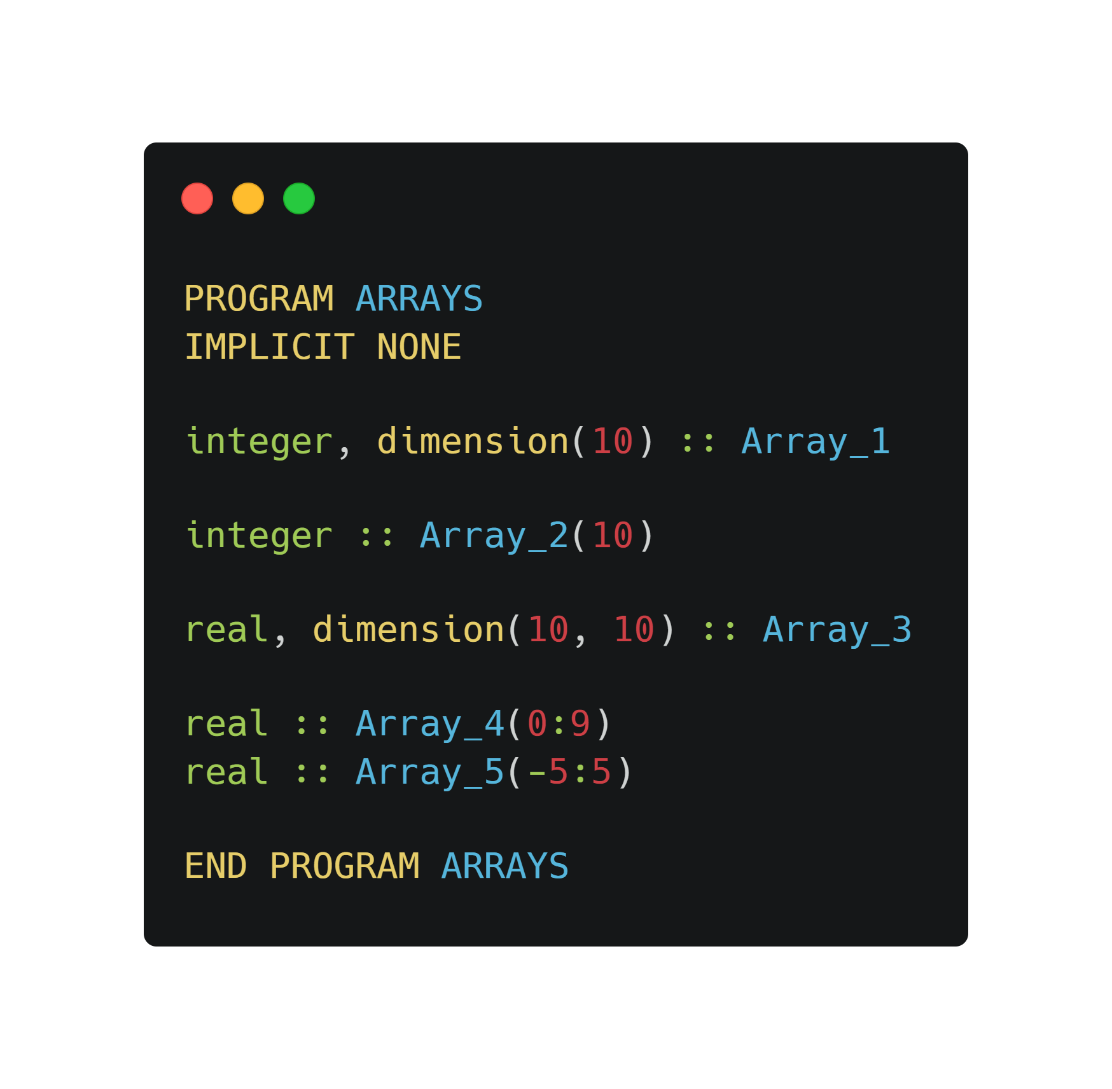
Array
Equivalent expressions
2-D array declaration 10x10
Custom index array declaration
C-like indexing (from 0 to n-1)
Symmetric index from -5 to 5

Slide 12
Array and memory allocation
Memory in computer
1 | 2 | 3 | 4 | 5 | 6 | 7 | 8 | 9 | 10 | 11 | 12
1 | 5 | 9
2 | 6 | 10
3 | 7 | 11
4 | 8 | 12
The data is stored in 1-D structure
We commonly define higher dimension (2~) arrays because they are familiar to human.
Array index just points out the memory location.
In Fortran, array is column-wise.
2-D array in code and our mind

Slide 13
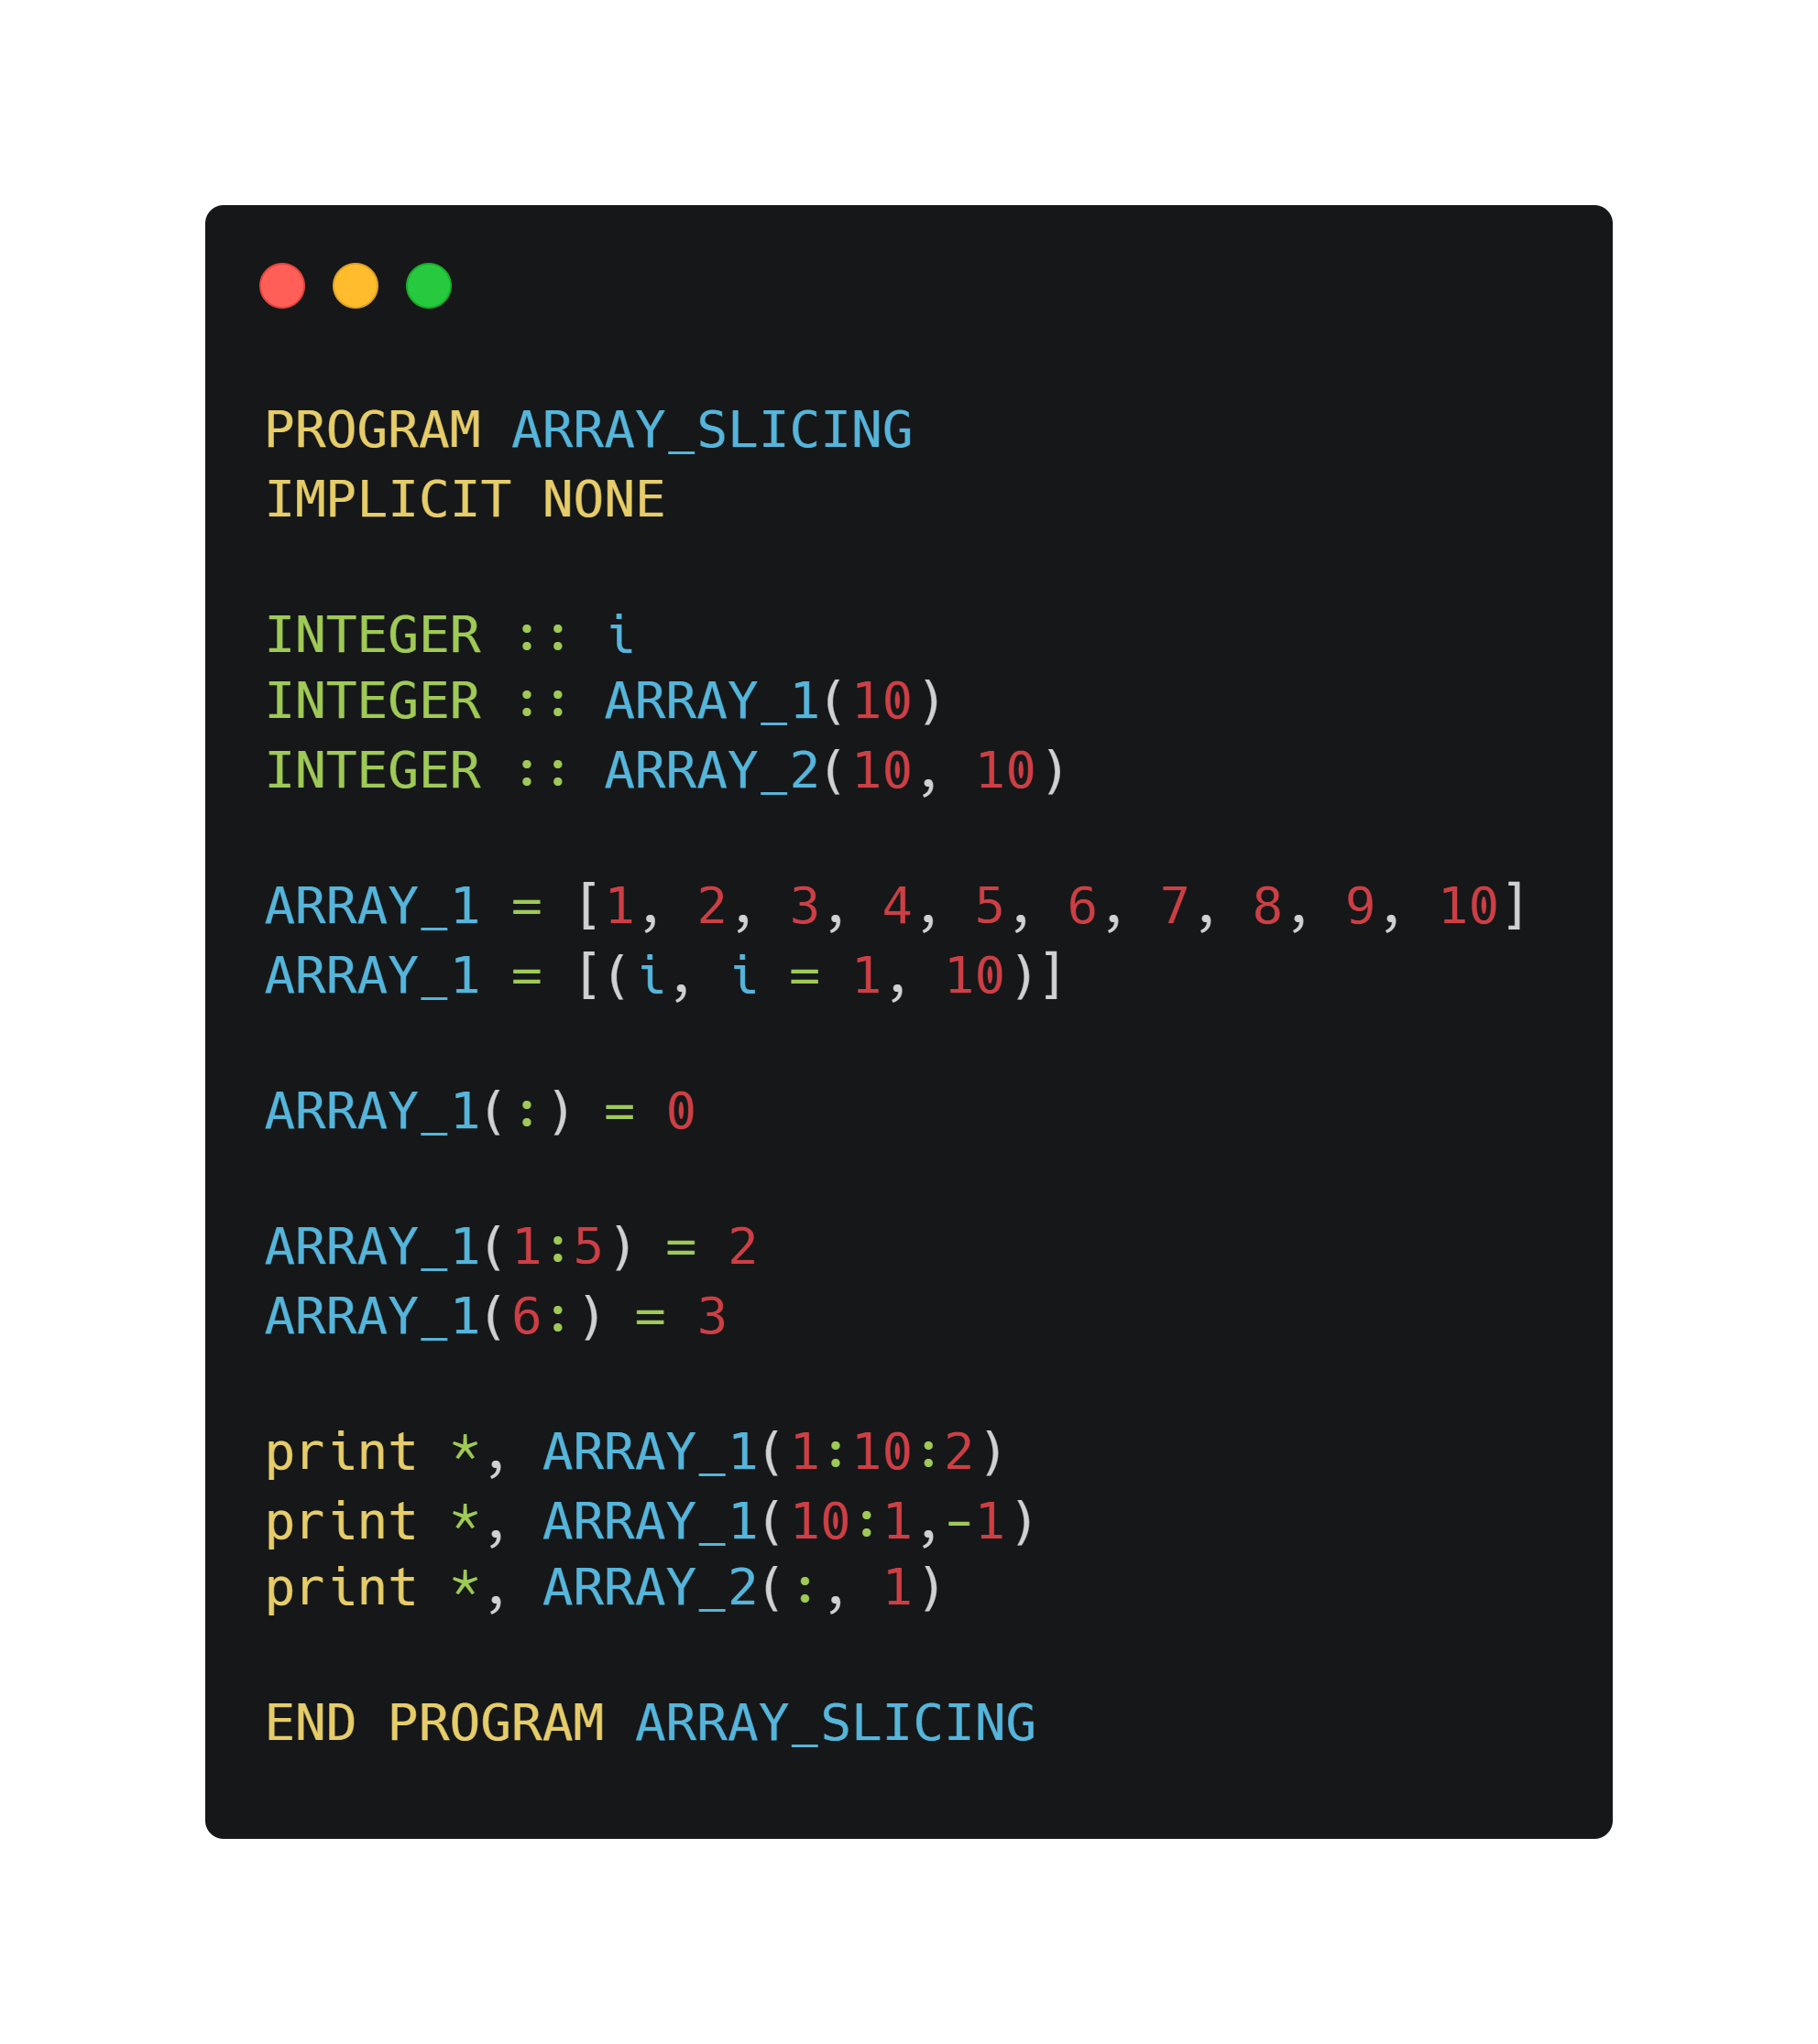
Array slicing
Do-loop construction
Range is denoted by ‘:’
Print the element of odd-index (i.e., 1, 3, 5, 7, 9)
Print the all the element inversely
Print the first column in a 2-D array

Slide 14
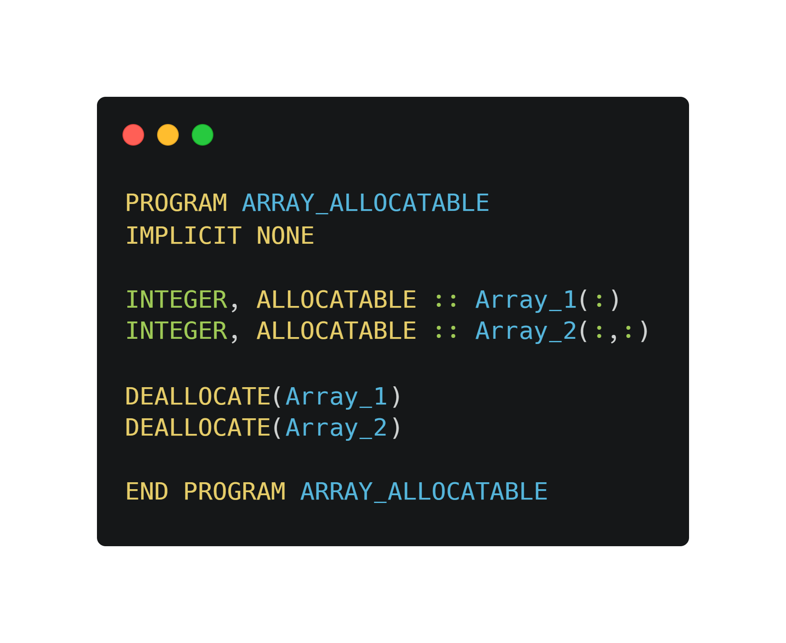
Allocatable arrays
Previous array declaration was static : we already knew their length of the arrays.
If we need to declare an array without identifying its size,
we use allocatable(dynamic) array.
It is useful for declaring an array when we copy from the data file.

Slide 15
What’s next?
Logical operations
Conditional
Loop (Iterations)
File read & write
Sample code (Sorting algorithm, Iso-water head)

Slide 16
Download links and useful resources
Visual Studio (Link) - Download the community - 2019 ver.
Intel Fortran compiler (Link) - Download the 2021.3 release
Fortran-lang (Link)
Lean Fortran in Y minutes (Link)
Cheat sheet by B. Evans (Link)
Mistakes in Fortran 90 programs that might you surprise (Link)
KMA education (in Korean) (Link)

Slide 17

One more thing!
A quick guide for Fortran with Intel Fortran compiler and Visual Studio

